Slide 1
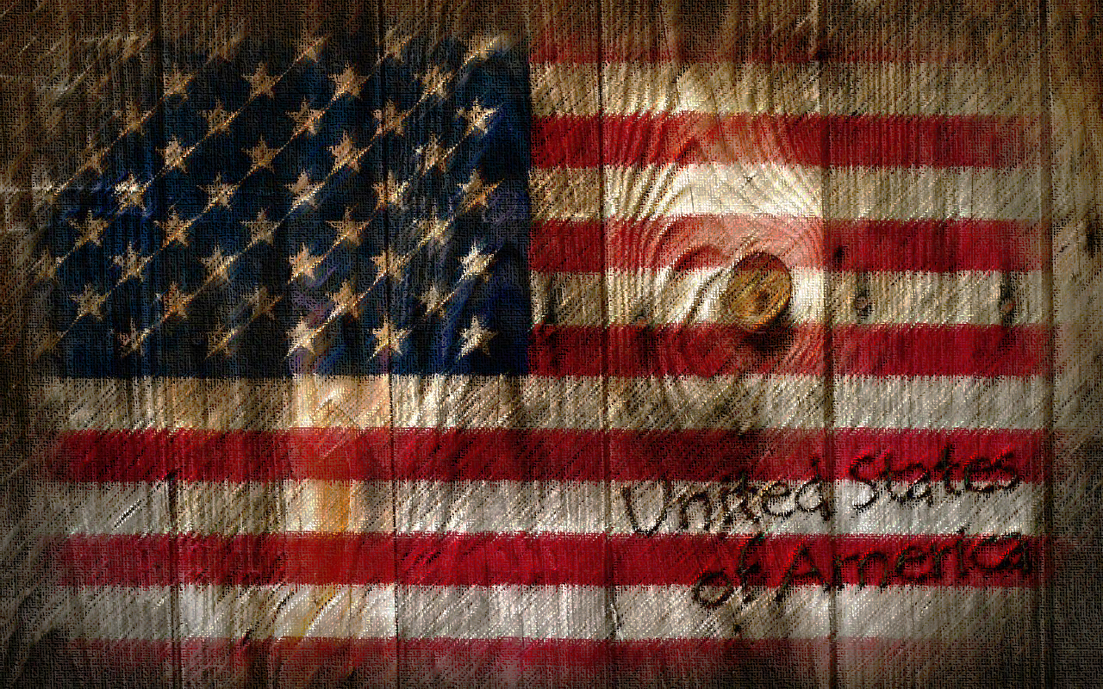
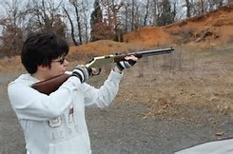
Gun Raffle Benefit Winfield Community VFD
Drawing Date: July 15, 2017 at the close of our 2017 Carnival
1st Prize: Henry Golden Boy 22lr Lever Action Rifle
2nd Prize: Mossberg Silver Reserve II 12 Gauge Over/Under Shotgun
Tickets: $5.00 each or 3 for $10.00 only 1000 tickets to be sold
www.winfieldvfd.org

